Slide 1
KNOWLEDGE BASED EXPERT SYSTEMS
Course Code: CSE508
Lecture 0

Slide 2
Introduction
An Expert System (ES) is a computer program
The first expert system was developed in 1965 by Edward Feigenbaum and Joshua Lederberg of Stanford University in California, U.S. Dendral, was designed to analyze chemical compounds.
solve complex problems and to provide decision-making ability like a human expert
It works by extracting knowledge from its knowledge base using the reasoning and inference rules according to the user queries
Notes:
So ,Guys how many of you are afraid of programming ???? , who think that coding is the most difficult thing to do ??? Pick one of them and ask him/her the recipe of Maggi or tea …

Slide 3
Introduction
Expert systems can be distinguished from other kinds of AI program because:
They deal with subjects of considerable complexity—subjects that normally require a good deal of human expertise.
provide expert-level solutions to complex problems. They must be fast and reliable;
They must be capable of explaining and justifying solutions
be understandable.
They must be sufficiently flexible that new information may be easily accomodated.
Notes:
So ,Guys how many of you are afraid of programming ???? , who think that coding is the most difficult thing to do ??? Pick one of them and ask him/her the recipe of Maggi or tea …

Slide 4
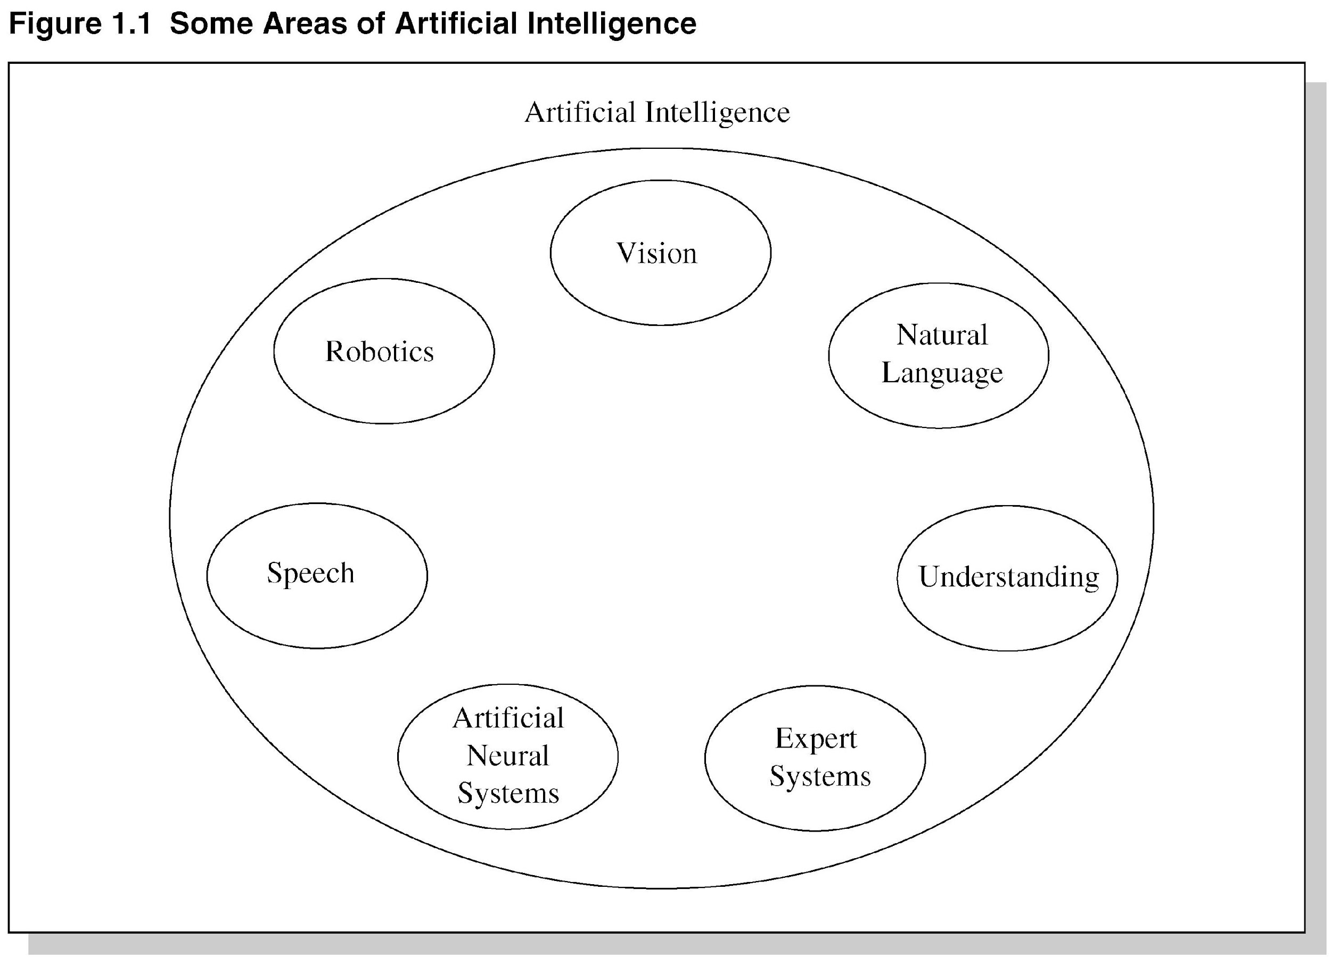

Slide 5
Introduction
ES are designed for a specific domain, such as medicine, science, etc.
One of the common examples of an ES is a suggestion of spelling errors while typing in the Google search box.
The more knowledge stored in the Knowledge Base(KB), the more that system improves its performance.
Notes:
So ,Guys how many of you are afraid of programming ???? , who think that coding is the most difficult thing to do ??? Pick one of them and ask him/her the recipe of Maggi or tea …

Slide 6
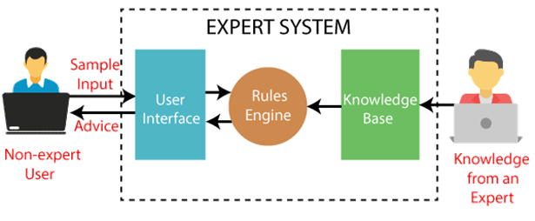
Introduction
Notes:
So ,Guys how many of you are afraid of programming ???? , who think that coding is the most difficult thing to do ??? Pick one of them and ask him/her the recipe of Maggi or tea …

Slide 7
Introduction
DENDRAL:
It was an artificial intelligence project
was made as a chemical analysis expert system
was used in organic chemistry to detect unknown organic molecules with the help of their mass spectra and knowledge base of chemistry.
Notes:
So ,Guys how many of you are afraid of programming ???? , who think that coding is the most difficult thing to do ??? Pick one of them and ask him/her the recipe of Maggi or tea …

Slide 8
Introduction
MYCIN:
was one of the earliest backward chaining expert systems
was designed to find the bacteria causing infections like bacteraemia and meningitis
It was also used for the recommendation of antibiotics and the diagnosis of blood clotting diseases.
Notes:
So ,Guys how many of you are afraid of programming ???? , who think that coding is the most difficult thing to do ??? Pick one of them and ask him/her the recipe of Maggi or tea …

Slide 9
Introduction
Pneumoconiosis X-Ray Diagnosis Expert System (PXDES):
an expert system that is used to determine the type and level of lung cancer
it takes a picture from the upper body, which looks like the shadow. This shadow identifies the type and degree of harm.
A computer-based clinical decision support system for early cancer detection(CaDeT):
The CaDet expert system is a diagnostic support system that can detect cancer at early stages.
Notes:
So ,Guys how many of you are afraid of programming ???? , who think that coding is the most difficult thing to do ??? Pick one of them and ask him/her the recipe of Maggi or tea …

Slide 10
History of Expert Systems
In 1959 Newell and Simon described General Problem Solver (GPS).
GPS:
Intended to solve general problems across domains. Example: theorem proof, geometric problem and chess playing.
First computer program to separate knowledge from strategy (generic solver engine).
Predecessor to ES.

Slide 11
History of Expert Systems (2)
ES introduced by Stanford Heuristic Programming Project led by Feigenbaum.
Mid-1960s: Early ES programs:
MYCIN:
Diagnose infectious diseases such as bacteremia and meningitis.
Recommend antibiotics.
Dosage adjusted for patient’s body weight.
Name derived from antibiotics (suffix – “mycin”).

Slide 12
History of Expert Systems (3)
Mid-1970s:
Recognition of the role of knowledge
Power of an ES comes from the specific knowledge it possesses, not from the inference schemes it employs.
Development of knowledge representation theories.
Development of decision making procedures and inferences.

Slide 13
Quiz 1
The first Expert System was introduced by
University of Cambridge
University of Oxford
Stanford University
None of these

Slide 14
Quiz 1
The first Expert System was introduced by
University of Cambridge
University of Oxford
Stanford University
None of these

Slide 15
History of Expert Systems (4)
Early 1980s:
Expert systems proliferated. Example: XCON, XSEL.
XCON (eXpert CONfigurator):
Used to assist in the ordering of DEC’s VAX computer system
Automatically selected the computer system components based on the customer’s requirements
Saved DEC $25M a year by speeding the assembly process and increasing customer satisfaction
eXpert SELling assistant(XSEL):
A newer version of XCON
Intended to be used by DEC’s salesforce

Slide 16
History of Expert Systems (5)
Universities offered expert system courses.
ES technology became commercial.
Programming tools and shells appeared. Example: EMYCIN, EXPERT.

Slide 17
Latest Developments in ES
Improvements in knowledge acquisition.
Software and expertise also available on internet.
Use of multiple knowledge bases.
Many tools to expedite the construction of ES at a reduced cost.
– eXpertise2Go provides a free expert system shell that provides the inference engine, acquisition and explanation interface.
Increased use of expert systems in many tasks like medical diagnosis, car diagnosis and financial advice.

Slide 18
Characteristics of Expert System
High Performance: The expert system provides high performance for solving any type of complex problem of a specific domain with high efficiency and accuracy.
Understandable: It responds in a way that can be easily understandable by the user. It can take input in human language and provides the output in the same way.
Reliable: It is much reliable for generating an efficient and accurate output.
Highly responsive: ES provides the result for any complex query within a very short period of time.

Slide 19
Components of an Expert System
Expert System
Stores knowledge (facts and rules)
Knowledge Base
Facts
User Interface
User
Expertise
Derives new knowledge from existing knowledge
Inference Engine

Slide 20
Components of Expert System
User Interface
Inference Engine
Knowledge Base

Slide 21
Components of Expert System
User Interface
the expert system interacts with the user,
takes queries as an input in a readable format,
and passes it to the inference engine.
After getting the response from the inference engine, it displays the output to the user.

Slide 22
Components of Expert System
Inference Engine(Rules of Engine)
brain of the expert system as it is the main processing unit of the system.
It applies inference rules to the knowledge base to derive a conclusion or deduce new information.
It helps in deriving an error-free solution of queries asked by the user.
With the help of an inference engine, the system extracts the knowledge from the knowledge base.

Slide 23
Components of Expert System
There are two types of inference engine:
Deterministic Inference engine: The conclusions drawn from this type of inference engine are assumed to be true. It is based on facts and rules.
Probabilistic Inference engine: This type of inference engine contains uncertainty in conclusions, and based on the probability.

Slide 24
Components of Expert System
Inference engine uses the below modes to derive the solutions:
Forward Chaining: It starts from the known facts and rules, and applies the inference rules to add their conclusion to the known facts.
Backward Chaining: It is a backward reasoning method that starts from the goal and works backward to prove the known facts.

Slide 25
Quiz 2
The part of Expert System that find the appropriate rules to apply
User interface
Knowledge base
Inference engine
None of these

Slide 26
Quiz 2
The part of Expert System that find the appropriate rules to apply
User interface
Knowledge base
Inference engine
None of these

Slide 27
Components of Expert System
Knowledge Base
a type of storage that stores knowledge acquired from the different experts of the particular domain.
a big storage of knowledge.
The more the knowledge base, the more precise will be the Expert System.
It is similar to a database that contains information and rules of a particular domain or subject.
One can also view the knowledge base as collections of objects and their attributes.

Slide 28
Components of Expert System
Knowledge Base
Components of Knowledge Base
Factual Knowledge: The knowledge which is based on facts and accepted by knowledge engineers comes under factual knowledge.
Heuristic Knowledge: This knowledge is based on practice, the ability to guess, evaluation, and experiences.

Slide 29
Components of Expert System
Knowledge Base
Components of Knowledge Base
Knowledge Representation: the knowledge stored in the knowledge base using the If-else rules.
Knowledge Acquisitions: It is the process of extracting, organizing, and structuring the domain knowledge, specifying the rules to acquire the knowledge from various experts, and store that knowledge into the knowledge base.

Slide 30
Need of Expert System
No memory Limitations
High Efficiency
Expertise in a domain
Not affected by emotions
High security
Considers all the facts
Regular updates improve the performance

Slide 31
Limitations of Expert System
The response of the expert system may get wrong if the knowledge base contains the wrong information.
Like a human being, it cannot produce a creative output for different scenarios.
Its maintenance and development costs are very high.
Knowledge acquisition for designing is much difficult.
For each domain, we require a specific ES, which is one of the big limitations.
It cannot learn from itself and hence requires manual updates.

Slide 32
Applications of Expert System
In designing and manufacturing domain manufacturing physical devices such as camera lenses and automobiles.
In the knowledge domain These systems are primarily used for publishing the relevant knowledge to the users. The two popular ES used for this domain is an advisor and a tax advisor.

Slide 33
Applications of Expert System
In the finance domain to detect any type of possible fraud, suspicious activity, and advise bankers that if they should provide loans for business or not.
In the diagnosis and troubleshooting of deceases In medical diagnosis, the ES system is used, and it was the first area where these systems were used.
Planning and Scheduling for planning and scheduling some particular tasks for achieving the goal of that task.

Slide 34
Quiz 3
The knowledge is based on practice, the ability to guess, evaluation, and
experiences.
Factual Knowledge
Heuristic Knowledge
Both
None of these

Slide 35
Quiz 3
The knowledge is based on practice, the ability to guess, evaluation, and
experiences.
Factual Knowledge
Heuristic Knowledge
Both
None of these

